Slide 1
Basketball Player Classification
Cheng Huang, Mangyue Sun, Yue Cheng, and Zhongnan Su

Slide 2
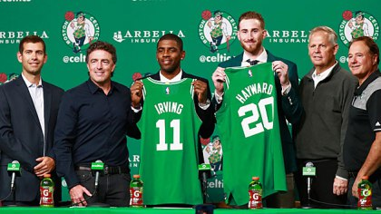
Introduction and Incentive
Helps GMs decide whom to sign.
Fans see who are the best players in the league.
http://boston.cbslocal.com/2017/09/01/kyrie-irving-gordon-hayward-introductory-press-conference-brad-stevens/

Slide 3
Goal
Three classification algorithms to separate players into three groups.
Compare the accuracy of the classification.

Slide 4
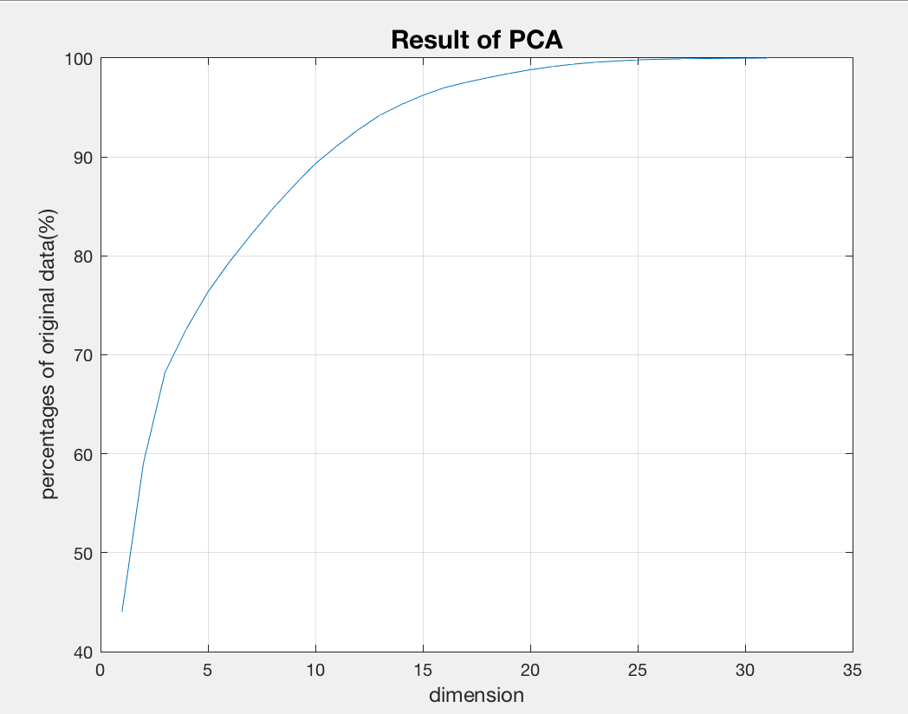
Data Processing
Principal Component Analysis(PCA) to reduce the feature dimension without loosing much accuracy.

Slide 5
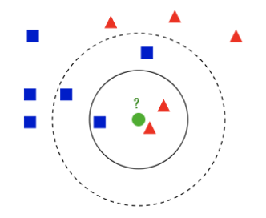
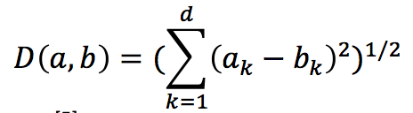
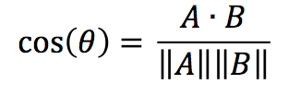
Classification Method --- KNN
In KNN, an object is classified by a majority vote of its neighbors.
The nearest-neighbor classifier relies on a metric or “distance” function between patterns.
Notes:
in the left picture, when k equals to 3, the green circle is assigned to the red triangles because there are 2 triangles and only 1 square inside the inner circle. But when k equals to 5, in the large dashed line circle, the green circle is classified to the blue square.

Slide 6
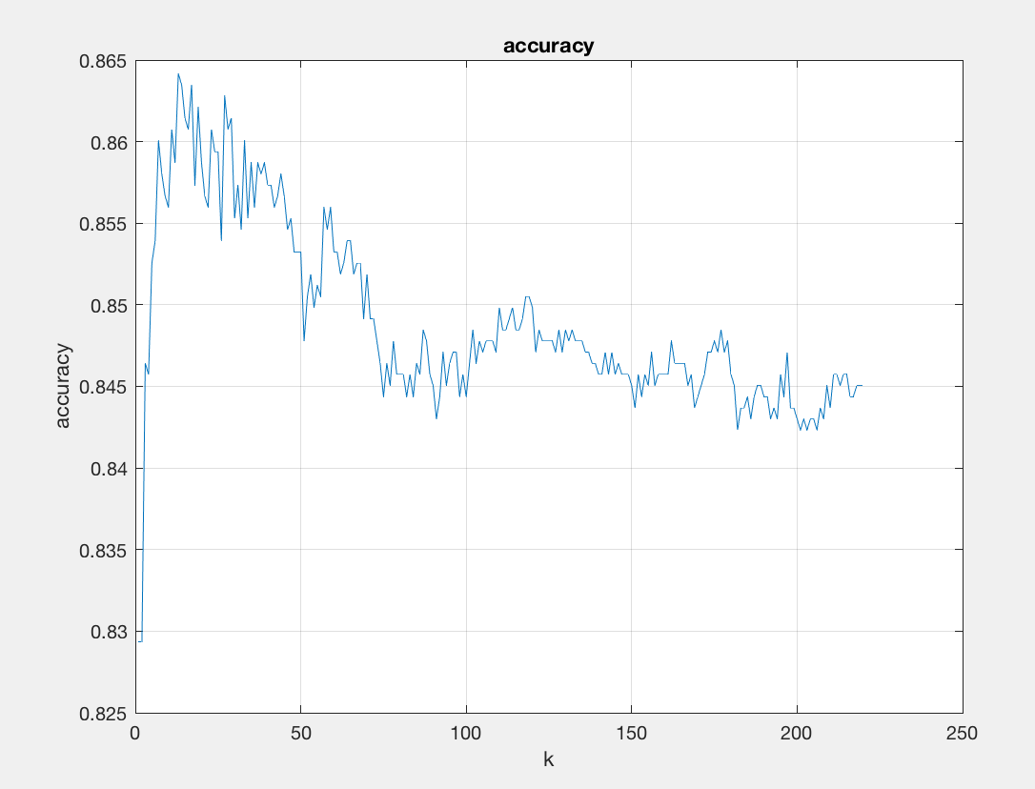
Classification Methods --- KNN
How to choose the value of K?
-Small K leads to higher noise on results.
-Large K makes it computationally expensive.
How to optimize value of K?

Slide 7
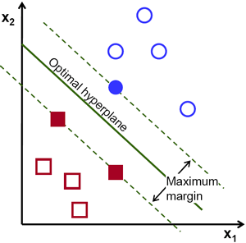
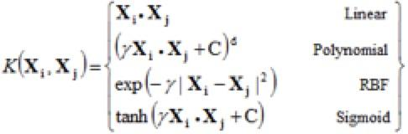
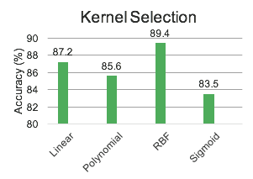
Classification Methods --- SVM
Support vector machines (SVM) are supervised learning used for classification and regression analysis
The optimal hyperplane maximizes the margins between different classes
SVM allows the original finite-dimensional space be mapped into higher-dimensional space, which makes the separation easier
Kernel function selection
Best kernel parameters are selected using 10-fold cross validation
Training dataset : test dataset = 9 : 1
Notes:
SVM algorithm is very effective with very clear margin of separation because it finds a hyperplane that separates the classes. The hyperplane is chosen by maximizing the distance between the hyperplane and the nearest data point. Here, the data is two dimensional, but SVM allows the original finite-dimensional space be mapped into higher-dimensional space to simplify the separation.
How to tune parameters of SVM?
Tuning parameters value for machine learning algorithms effectively improves the model performance. They are calculated using cross validation method.

Slide 8
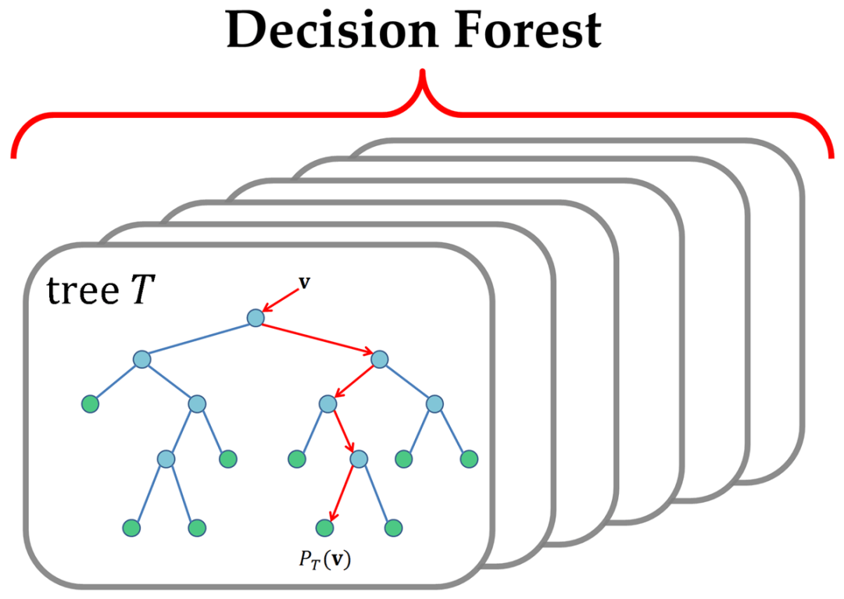
Classification Method --- Random Forest
Ensemble learning algorithm
Better than single decision tree
Avoid overfitting
Notes:
Random forest is an ensemble learning algorithm which can be used for classification and regression. The random forest contains multiple decision trees, each of which is generated by randomly chosen features. Random forest usually has more accuracy over single decision tree and it can avoid the overfitting problem bought by a single decision tree. Also, it’s efficient, so this algorithm is ideal of processing scalable data.

Slide 9
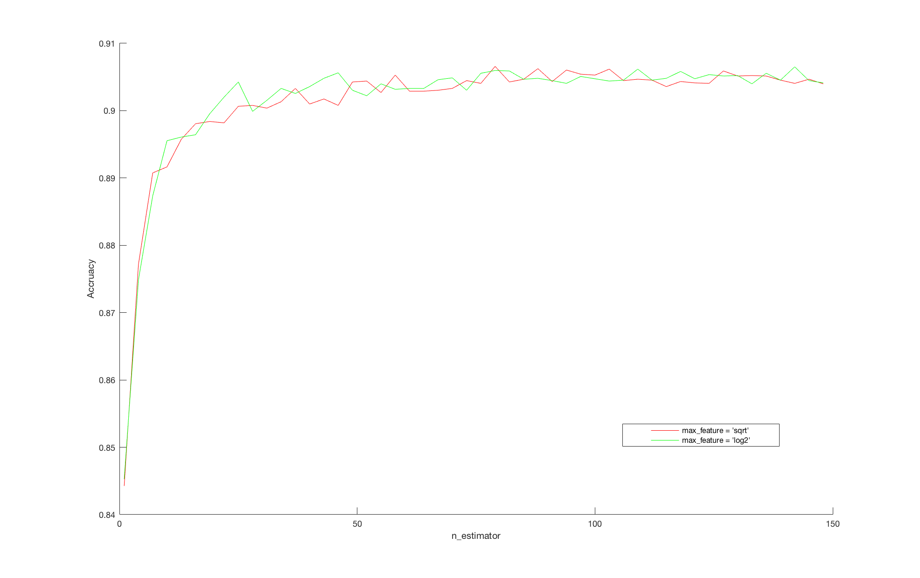
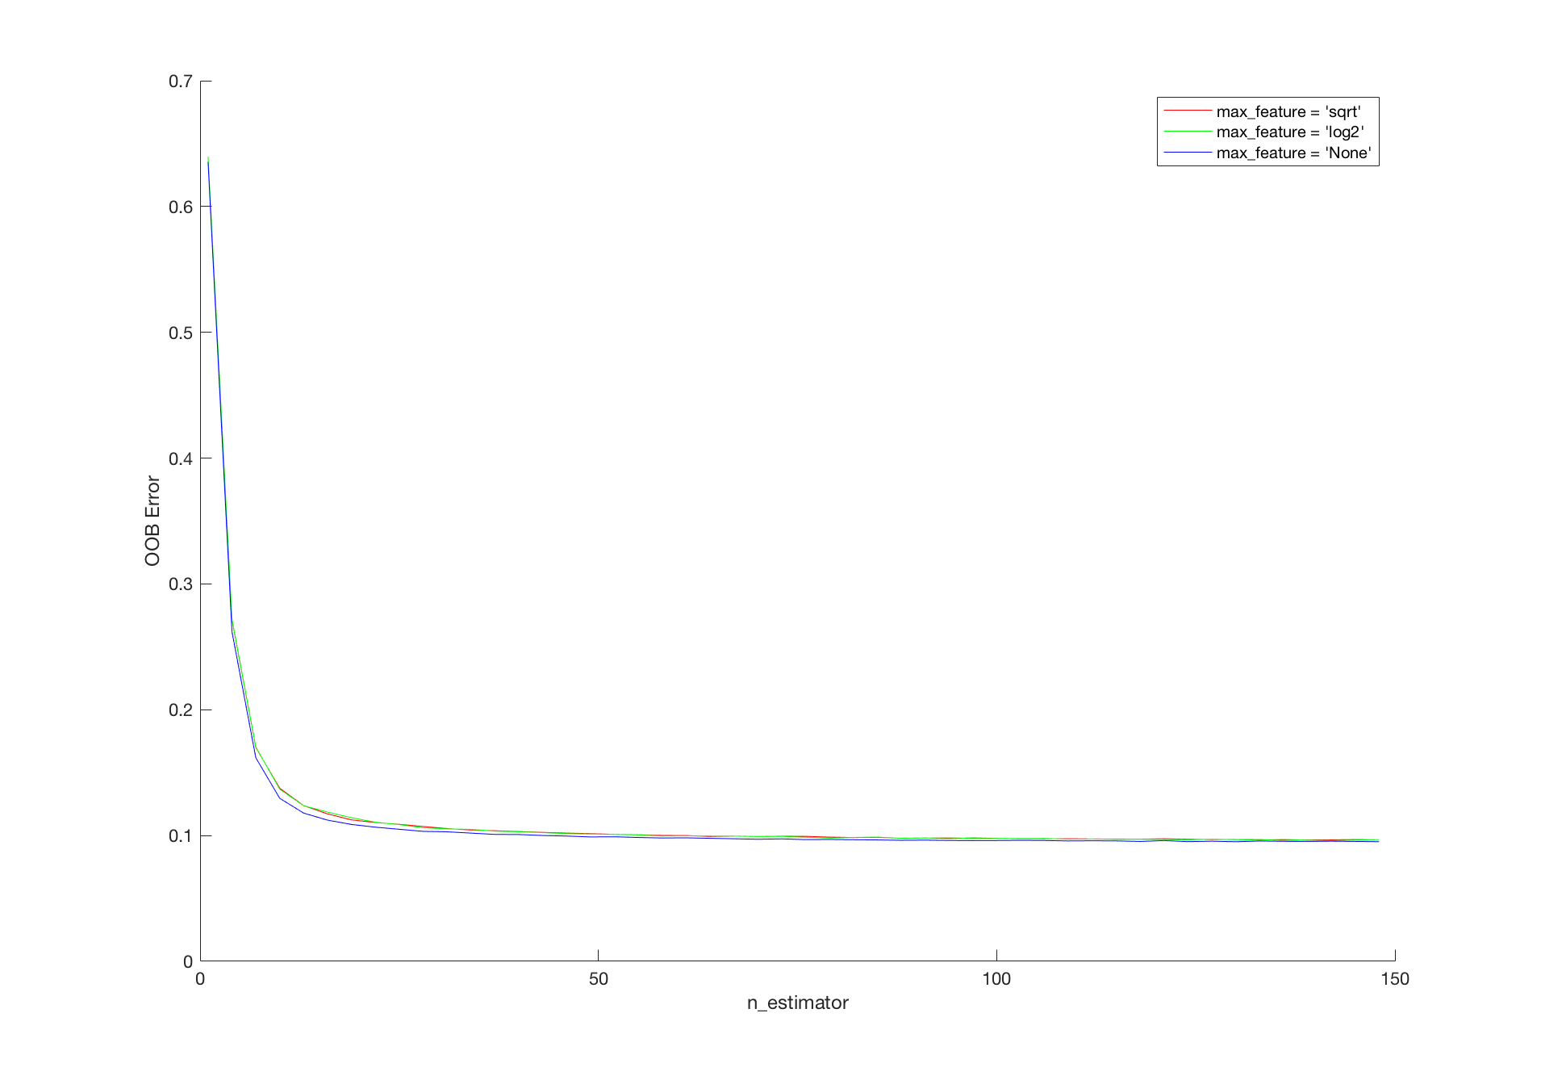
Classification Method --- Random Forest
Notes:
As we can see in the figure, with the number of trees increase, more accuracy prediction we will get and we will get lower out-of-bag error. Since only 35 features is taking into account, we can see little change when we alter the feature count of constructing a single decision tree in the forest.

Slide 10
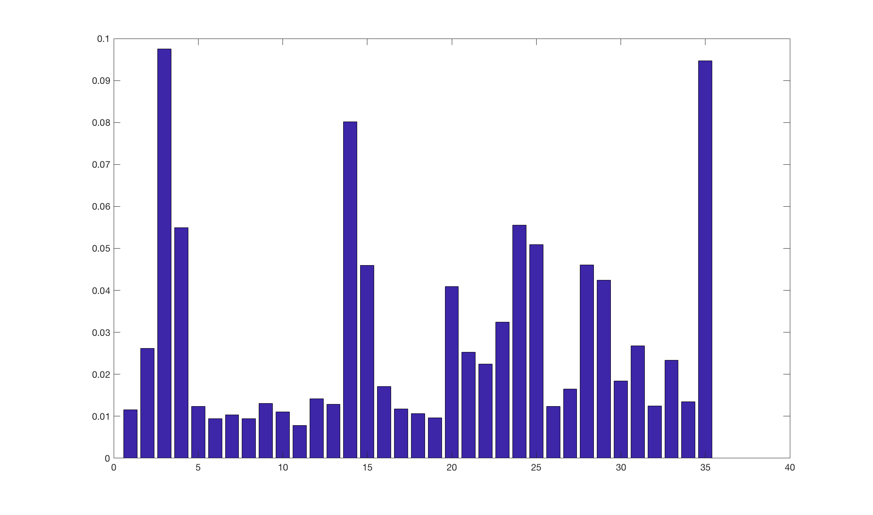
Classification Method --- Random Forest
Notes:
The random forest can also be used in regression and finding the importance of each feature. The mean square error of test samples is 0.7 when predicting the wining share of each player. And This figure shows that the MP (Minute played), FG (Field Goal) and the overall points are the top 3 important features to consider the performance of the player.

Slide 11
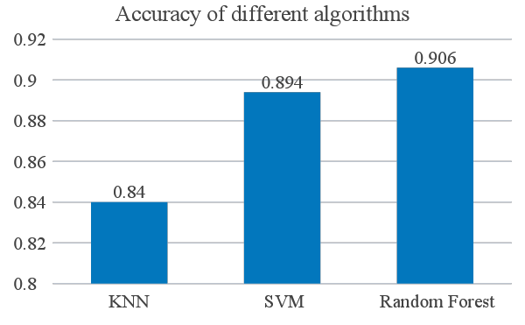
Conclusion

